Slide 1
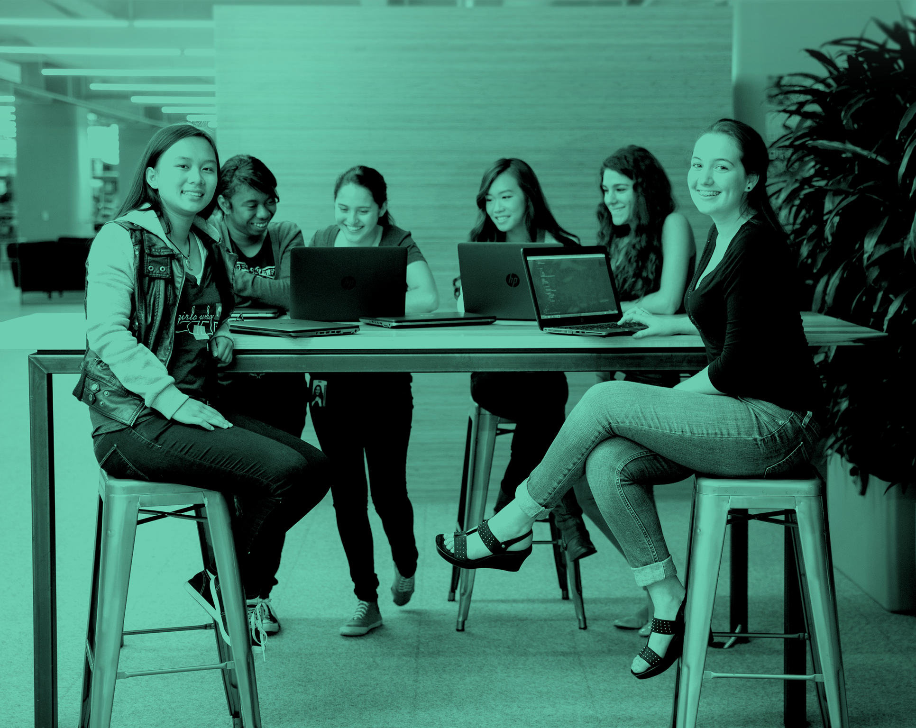
Girls Who Code Teacher Training
Scratch - Intro
‹#›
Notes:
Session plan found here: https://docs.google.com/document/d/1-rtG9QWBIygUcapxW4HBTEETCKfW_h-LbZxDWavTrkw/edit

Slide 2
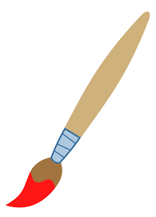


HOOK
Which of these items doesn’t belong?
Notes:
3 min to find a partner to talk.
1 min to share out/return to seats
1 min - Analogies and connections to real life are great ways to explain these coding concepts to students. We are going to leverage this during this session.

Slide 3

CONTENT IN CONTEXT
Unit 1: Fundamentals
Unit 2: Applications
Unit 3: Advanced Topics
Unit 4:
Final Projects
When?: Week 1
Why?: No syntax errors, just logic. Vibrant online community.
Related Project?: Side Scroller
Notes:
< 1 min
Pause to give them time to read.
Say: The content we are going to learn and experiment with during this session falls near the end of SIP, after girls have learned all of the rest of their content.

Slide 4
OBJECTIVES
By the end of this session, GTWBAT:
Use Scratch to solve a challenge
Explain how Scratch uses at least one programming concept
Notes:
Call on a teacher to read this
GTWBAT = Great teachers will be able to
Say:
What this is, what this isn’t:
It is going to give you some time to refresh introductory vocabulary.
It isn’t going to teach you everything about object oriented programming.
It is going to connect you to resources where you can refresh your syntactical skills
It isn’t going to teach you all of the dots, commas and colons you need to create your own class.

Slide 5
Agenda
Hook / Objectives - 2 min
Intro Scratch 1 min
Create something in Scratch - 4 min
Discuss! 5 min
Notes:
Call on a teacher to read this
GTWBAT = Great teachers will be able to
Say:
What this is, what this isn’t:
It is going to give you some time to refresh introductory vocabulary.
It isn’t going to teach you everything about object oriented programming.
It is going to connect you to resources where you can refresh your syntactical skills
It isn’t going to teach you all of the dots, commas and colons you need to create your own class.

Slide 6
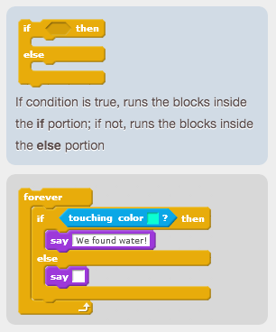
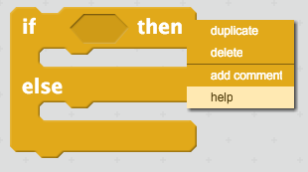
Where to Find Help
Notes:
Call on a teacher to read this
GTWBAT = Great teachers will be able to
Say:
What this is, what this isn’t:
It is going to give you some time to refresh introductory vocabulary.
It isn’t going to teach you everything about object oriented programming.
It is going to connect you to resources where you can refresh your syntactical skills
It isn’t going to teach you all of the dots, commas and colons you need to create your own class.

Slide 7
Challenge
2 minute:
Draw a square in Scratch
If time: Draw a square in Scratch in a different way
1 minute:
Turn and talk to your neighbor - how did they draw a square
1 minute:
Whole group
Notes:
1) Constructionism - Piaget noticed that kids construct their own knowledge. He called this “Constructivism” Papert took this one step further, deciding the best way to construct knowledge was through actually building things. Scratch, and our curriculum is meant to be largely based on that too. Papert felt like when curricula wasn’t working, people would try to improve Instruction. All the improved instruction in the world wouldn’t help, he believed, until we allowed students to CONSTRUCT their knowledge. Constructionism > Instructionism.
2) Objects to Think With - Papert knew that we learned from the objects around us. He learned from the gears he played with as a child. What was also important to him was that _he fell in love with the gears_. The best objects to think with are objects you care about, objects you can engage with. Scratch is very sprite-based. That is entirely by design. You can care about and engage with Scratch Sprites.
3) Powerful Ideas. The Cover of the Mindstorms book reads “Children, Computers, and Powerful Ideas” Papert often was dismayed that people seemed to remember the first two, and he found giving more children more computers entirely pointless without Powerful Ideas. Mitch thought of these powerful ideas as assumptions that young students can understand feedback, for example when you lean in one direction your body compensates in the other. Debugging is a powerful idea. Scratch (and our curriculum) gives students the chance to do that.
4) Samba Schools - In schools in Brazil, students learned with and from their surrounding community. This has become easier to do with the internet, and the Scratch Community is meant to be a Samba School. Our sisterhood is too.
5) Hard Fun. Papert believed that students didn’t shy away from schoolwork because it was hard, they shied away because it was boring. Students are more than willing to put in the hard work if they care about what they’re learning. I agree with this so very much, and try to build curricula around it.
6) Epistemological Pluralism. There are many ways to learn things. There are multiple ways of knowing, multiple ways of understanding the world, multiple ways of understanding yourself. Too often, school encourages one kind of learning. We need creating and analysis. This is another thing I try to put in every curriculum I’m a part of

Slide 8
Closing
What ways that you saw people solve things surprised you?
What is one programming concept you used?

Slide 9
Girls Who Code Teacher Training
Scratch - What can you do with Scratch?
‹#›
Notes:
Session plan found here: https://docs.google.com/document/d/1-rtG9QWBIygUcapxW4HBTEETCKfW_h-LbZxDWavTrkw/edit

Slide 10
OBJECTIVES
By the end of this session, GTWBAT:
Give at least two examples of the kinds of projects Scratch can create
Give at least one reason Girls Who Code uses Scratch
Explain how Scratch uses at least one programming concept
Notes:
Call on a teacher to read this
GTWBAT = Great teachers will be able to
Say:
What this is, what this isn’t:
It is going to give you some time to refresh introductory vocabulary.
It isn’t going to teach you everything about object oriented programming.
It is going to connect you to resources where you can refresh your syntactical skills
It isn’t going to teach you all of the dots, commas and colons you need to create your own class.

Slide 11
Agenda
Hook / Objectives - 2 min
Explore 5 min
a game
music
tutorial
art
Discuss! 5 min
Notes:
Call on a teacher to read this
GTWBAT = Great teachers will be able to
Say:
What this is, what this isn’t:
It is going to give you some time to refresh introductory vocabulary.
It isn’t going to teach you everything about object oriented programming.
It is going to connect you to resources where you can refresh your syntactical skills
It isn’t going to teach you all of the dots, commas and colons you need to create your own class.

Slide 12
Scratch Project Example - Game
The Journey of an Immigrant Kid in Scratch
(Created by a middle schooler to create empathy)
Questions:
What programming concepts did this person use?
What would you have to know to create this game in Python? JavaScript?
How was this person able to express themselves through Scratch?
Anything else you notice?

Slide 13
Scratch Project Example - Music
Playable Score in Scratch (complicated)
Sample Band in Scratch (play note)
(Sarah doesn’t know who made these)
Questions:
What programming concepts did this person use?
What would you have to know to create this project in Python? JavaScript?
How was this person able to express themselves through Scratch?
Anything else you notice?

Slide 14
Scratch Project Example - Tutorial
You Gotta <3 Variables in Scratch
(Created by a teenage Scratcher)
Questions:
What programming concepts did this person use?
What would you have to know to create this project in Python? JavaScript?
How was this person able to express themselves through Scratch?
Anything else you notice?

Slide 15
Scratch Project Example - Art
Lace in Scratch
(Created by a seasoned Scratcher who has been playing with it since she was 10)
Questions:
What programming concepts did this person use?
What would you have to know to create this project in Python? JavaScript?
How was this person able to express themselves through Scratch?
Anything else you notice?

Slide 16
Closing
Tell us which project you looked at, then answer the question:
What programming concepts did this person use?
What would you have to know to create this project in Python? JavaScript?
How was this person able to express themselves through Scratch?
Anything else you notice?

Slide 17
Girls Who Code Teacher Training
Scratch - Challenges
‹#›
Notes:
Session plan found here: https://docs.google.com/document/d/1-rtG9QWBIygUcapxW4HBTEETCKfW_h-LbZxDWavTrkw/edit

Slide 18
OBJECTIVES
By the end of this session, GTWBAT:
Use Scratch to solve a challenge
Explain how Scratch uses at least one programming concept
Notes:
Call on a teacher to read this
GTWBAT = Great teachers will be able to
Say:
What this is, what this isn’t:
It is going to give you some time to refresh introductory vocabulary.
It isn’t going to teach you everything about object oriented programming.
It is going to connect you to resources where you can refresh your syntactical skills
It isn’t going to teach you all of the dots, commas and colons you need to create your own class.

Slide 19
Agenda
Hook / Objectives - 2 min
Intro Scratch 1 min
Create something in Scratch - 4 min
Discuss! 5 min
Notes:
Call on a teacher to read this
GTWBAT = Great teachers will be able to
Say:
What this is, what this isn’t:
It is going to give you some time to refresh introductory vocabulary.
It isn’t going to teach you everything about object oriented programming.
It is going to connect you to resources where you can refresh your syntactical skills
It isn’t going to teach you all of the dots, commas and colons you need to create your own class.

Slide 20
Challenges - Choose 1
Whenever you press the B key, the sprite gets a little bigger. Whenever you press the S key, the sprite gets a little smaller.
Whenever two sprites collide, one of them says: “Excuse me.”
Whenever you click on a sprite, all other sprites do a dance.

Slide 21
Classroom Protocol - Mini-Presentation
Split into groups of 4 or 5.
Have students identify whose birthday is coming up next. They will be first to present.
Set a timer for 30 seconds.
Allow the first set of students (one from each group) present their work to their group.
When the timer goes off, set it anew and instruct the next set starts.

Slide 22
Closing
What new thing did you learn about Scratch? (Or, if you already know Scratch well, what thing do you think it is important or interesting to share?)
How does Scratch help students answer the essential questions?
What is Computer Science?
Who are Computer Scientists?

Slide 23
Girls Who Code Teacher Training
Scratch - Why?
‹#›
Notes:
Session plan found here: https://docs.google.com/document/d/1-rtG9QWBIygUcapxW4HBTEETCKfW_h-LbZxDWavTrkw/edit

Slide 24
Agenda
Hook / Objectives / Overview - 5 min
Scratch project example - 5 min
Discussion - 5 min
Notes:
Call on a teacher to read this
GTWBAT = Great teachers will be able to
Say:
What this is, what this isn’t:
It is going to give you some time to refresh introductory vocabulary.
It isn’t going to teach you everything about object oriented programming.
It is going to connect you to resources where you can refresh your syntactical skills
It isn’t going to teach you all of the dots, commas and colons you need to create your own class.

Slide 25
OBJECTIVES
By the end of this session, GTWBAT:
Give at least one reason Scratch is awesome
Give at least one reason why Girls Who Code uses Scratch
Notes:
Call on a teacher to read this
GTWBAT = Great teachers will be able to
Say:
What this is, what this isn’t:
It is going to give you some time to refresh introductory vocabulary.
It isn’t going to teach you everything about object oriented programming.
It is going to connect you to resources where you can refresh your syntactical skills
It isn’t going to teach you all of the dots, commas and colons you need to create your own class.

Slide 26
Scratch Project Example
https://scratch.mit.edu/projects/120001186
Questions:
Why does bubble103 love Scratch?
Check out the programming. What programming concepts did bubble103 have to use in order to create this program?
Did anything surprise you about this project?
Notes:
Call on a teacher to read this
GTWBAT = Great teachers will be able to
Say:
What this is, what this isn’t:
It is going to give you some time to refresh introductory vocabulary.
It isn’t going to teach you everything about object oriented programming.
It is going to connect you to resources where you can refresh your syntactical skills
It isn’t going to teach you all of the dots, commas and colons you need to create your own class.

Slide 27
CLOSING: HOW DID WE DO?
By the end of this session, GTWBAT:
Give at least one reason Scratch is awesome
Give at least one reason why Girls Who Code uses Scratch
Notes:
Call on a teacher to read this
GTWBAT = Great teachers will be able to
Say:
What this is, what this isn’t:
It is going to give you some time to refresh introductory vocabulary.
It isn’t going to teach you everything about object oriented programming.
It is going to connect you to resources where you can refresh your syntactical skills
It isn’t going to teach you all of the dots, commas and colons you need to create your own class.

Slide 28
CLOSING: THANK YOU!
Notes:
Call on a teacher to read this
GTWBAT = Great teachers will be able to
Say:
What this is, what this isn’t:
It is going to give you some time to refresh introductory vocabulary.
It isn’t going to teach you everything about object oriented programming.
It is going to connect you to resources where you can refresh your syntactical skills
It isn’t going to teach you all of the dots, commas and colons you need to create your own class.

Slide 29
Girls Who Code Teacher Training
Scratch - Lots of ways to explore
‹#›
Notes:
Session plan found here: https://docs.google.com/document/d/1-rtG9QWBIygUcapxW4HBTEETCKfW_h-LbZxDWavTrkw/edit

Slide 30
HOOK
How does Scratch do these things?
1) Constructionism - learning through building
2) Objects to Think With - we learn through the objects around us
3) Powerful Ideas - such as debugging
4) Samba Schools - learn with and through community
5) Hard Fun - students like hard things… as long as they’re fun.
6) Epistemological Pluralism - many ways to learn things.
Notes:
1) Constructionism - Piaget noticed that kids construct their own knowledge. He called this “Constructivism” Papert took this one step further, deciding the best way to construct knowledge was through actually building things. Scratch, and our curriculum is meant to be largely based on that too. Papert felt like when curricula wasn’t working, people would try to improve Instruction. All the improved instruction in the world wouldn’t help, he believed, until we allowed students to CONSTRUCT their knowledge. Constructionism > Instructionism.
2) Objects to Think With - Papert knew that we learned from the objects around us. He learned from the gears he played with as a child. What was also important to him was that _he fell in love with the gears_. The best objects to think with are objects you care about, objects you can engage with. Scratch is very sprite-based. That is entirely by design. You can care about and engage with Scratch Sprites.
3) Powerful Ideas. The Cover of the Mindstorms book reads “Children, Computers, and Powerful Ideas” Papert often was dismayed that people seemed to remember the first two, and he found giving more children more computers entirely pointless without Powerful Ideas. Mitch thought of these powerful ideas as assumptions that young students can understand feedback, for example when you lean in one direction your body compensates in the other. Debugging is a powerful idea. Scratch (and our curriculum) gives students the chance to do that.
4) Samba Schools - In schools in Brazil, students learned with and from their surrounding community. This has become easier to do with the internet, and the Scratch Community is meant to be a Samba School. Our sisterhood is too.
5) Hard Fun. Papert believed that students didn’t shy away from schoolwork because it was hard, they shied away because it was boring. Students are more than willing to put in the hard work if they care about what they’re learning. I agree with this so very much, and try to build curricula around it.
6) Epistemological Pluralism. There are many ways to learn things. There are multiple ways of knowing, multiple ways of understanding the world, multiple ways of understanding yourself. Too often, school encourages one kind of learning. We need creating and analysis. This is another thing I try to put in every curriculum I’m a part of

Slide 31
Agenda
Hook / Objectives - 2 min
Paddle Ball Challenge - 8 min
Show Sarah’s solution - 1 min
Closing - 2 min
Notes:
Call on a teacher to read this
GTWBAT = Great teachers will be able to
Say:
What this is, what this isn’t:
It is going to give you some time to refresh introductory vocabulary.
It isn’t going to teach you everything about object oriented programming.
It is going to connect you to resources where you can refresh your syntactical skills
It isn’t going to teach you all of the dots, commas and colons you need to create your own class.

Slide 32
Challenge
Paddle Ball
Start with this starter code
Make the bouncing ball code easier to read - use “More blocks” functions
Make the paddles move up and down
Make sure the paddles don’t move off the screen
Notes:
Call on a teacher to read this
GTWBAT = Great teachers will be able to
Say:
What this is, what this isn’t:
It is going to give you some time to refresh introductory vocabulary.
It isn’t going to teach you everything about object oriented programming.
It is going to connect you to resources where you can refresh your syntactical skills
It isn’t going to teach you all of the dots, commas and colons you need to create your own class.

Slide 33
Challenge
Paddle Ball
Sarah’s code
Notes:
Call on a teacher to read this
GTWBAT = Great teachers will be able to
Say:
What this is, what this isn’t:
It is going to give you some time to refresh introductory vocabulary.
It isn’t going to teach you everything about object oriented programming.
It is going to connect you to resources where you can refresh your syntactical skills
It isn’t going to teach you all of the dots, commas and colons you need to create your own class.

Slide 34
REFLECTION: BIG PICTURE
Discuss with a partner:
How might learning about Scratch inform or change a student’s answer to one of the Essential Questions below?
What is Computer Science?
Who are computer scientists?
How might this project help girls build the qualities in the Learner Profile?
Notes:
< 1 min
Say: We are going to be operating at the lesson/decision level for the next 90 minutes, but we’ll pull out and look bigger picture at the end.

